Slide 1
Welcome to Kindergarten!
Oakridge
Elementary
School
Friday, March 8, 2024

Slide 2
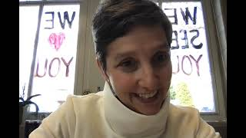
Welcome from Dr. Wright!

Slide 3
Notes:
You can read the description of “what is the pta” and list some of the wonderful ways they support the school

Slide 4
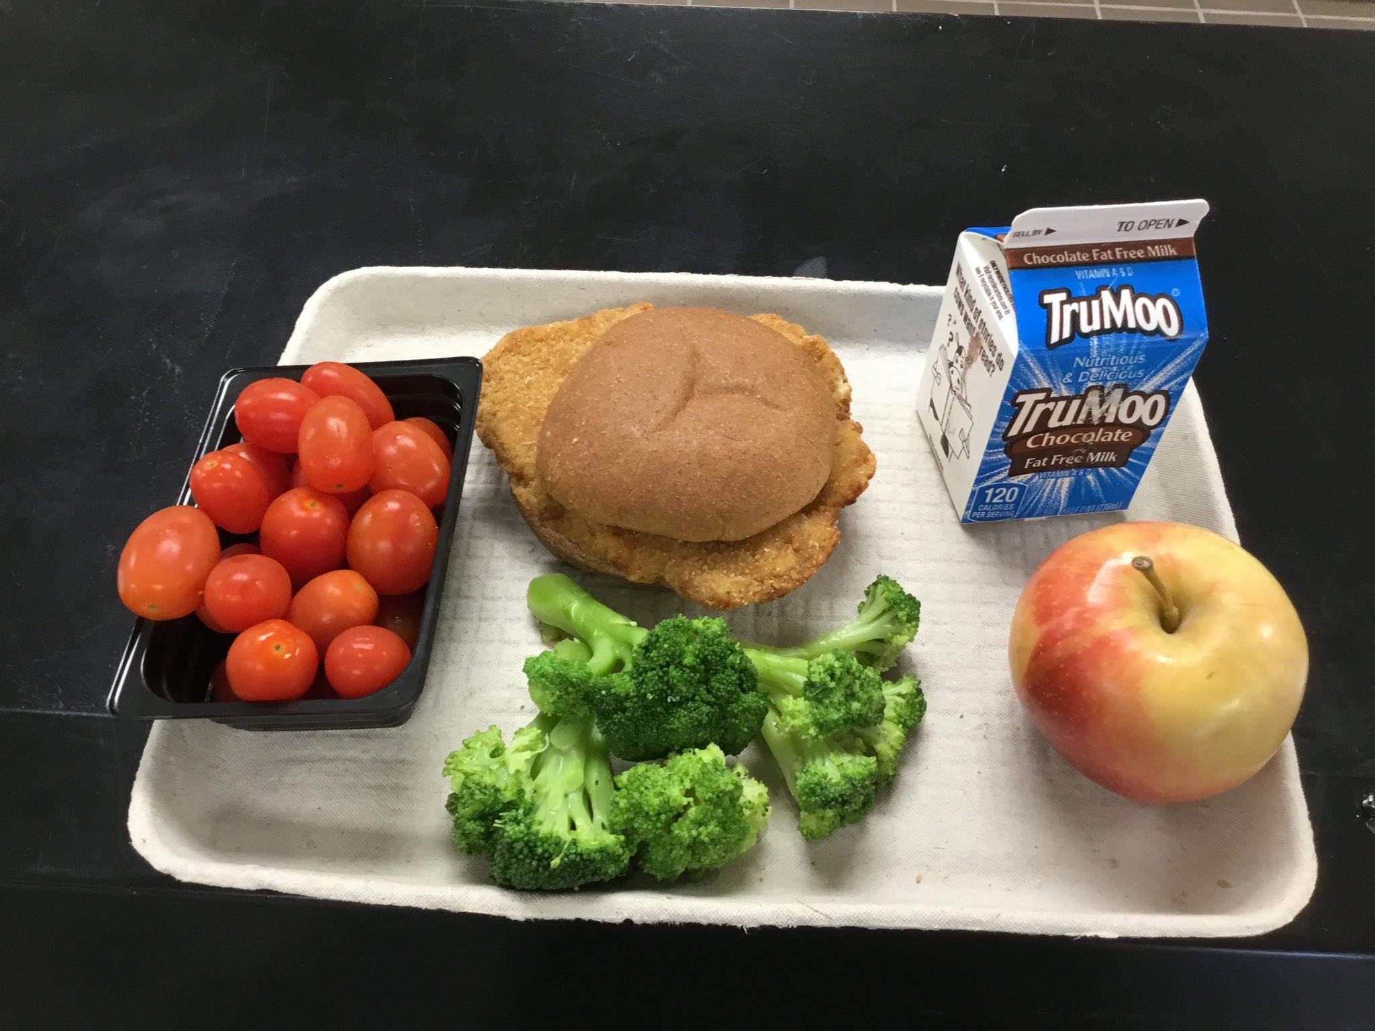
Meals
Breakfast
Lunch
Students have the option to eat breakfast daily in their classrooms from 8:40-9:10.
School breakfast costs $2.00.
Students go to recess and after, eat lunch in the cafeteria. This year, Kindergarten went to recess at 11:00 and ate lunch at 11:30. They also have an afternoon snack.
School lunch costs $3.25.
Notes:
Teachers: add grade level lunch time.
Read or summarize the meal info.
You can use the MySchoolBucks app/website to make payments to your child’s meal account , view cafeteria purchases, track meal account balances and more.

Slide 5
Instruction
Arlington
Public
Schools

Slide 6
APS Elementary Instruction
High Quality Tier I Instruction For All
Universal Screeners and Assessments
Differentiated Enrichment &
Intervention
All students are screened 3x year using validated measures to identify areas of need
Common formative and summative assessments
All students receive grade-level instruction using high quality curriculum grounded in research
Teachers provide differentiated small group instruction to meet the needs of every learner
Notes:
Teachers: As you walk parents through these slides please address the following key points:
The goal of APS academics is to ignite a passion for learning with equitable access and multiple pathways where learners connect, create, and innovate. Here are the ways our school will accomplish this:
All students receive grade level instruction using high quality curriculum grounded in research.
All students are screened three times a year to identify areas of need in reading and math. Common formative and summative assessments are given to measure student growth and achievement.
Teachers provide differentiated small group instruction to meet the needs of the learners.

Slide 7
Universal Screeners
English/Language Arts
Math
3x/year
PALS series (revisions of this screener will start 24-25 SY)
(through 2nd Grade)
DIBELS
(through 5th Grade)
2x/year
VKRP
Virginia Kindergarten Readiness Program
Assess math & social skills
Notes:
Universal screeners are administered in English/Language Arts and Math.

Slide 8
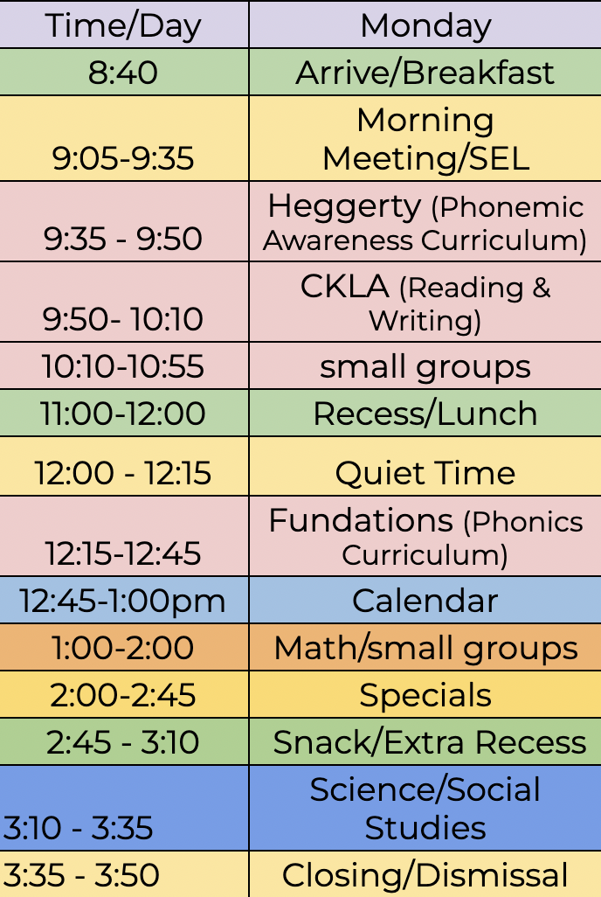
Sample Kindergarten
Schedule

Slide 9
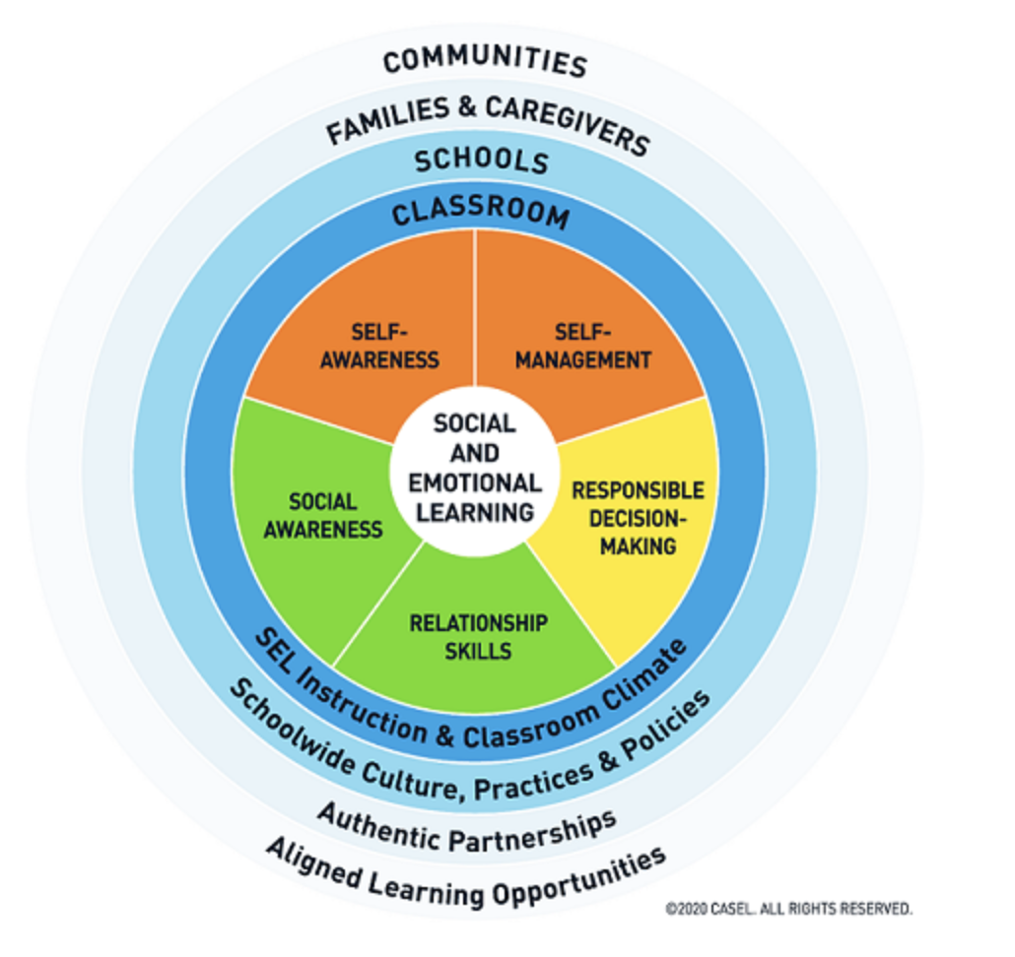
Social Emotional Learning
Focus on Tier 1 instruction: 20-30 minutes of daily time focused on explicit SEL instruction using Second Step curriculum
Aligned to 5 SEL competencies and curriculum frameworks outlined by VDOE
APS has set three SEL priorities:
Provide ongoing learning for all staff in SEL competencies and curricular resources
Provide students ongoing opportunities to learn and practice SEL
Prioritize regular, individualized outreach to students, families, and staff to continuously improve our support systems
SEL 3 Signature Practices
Notes:
With a focus on integrating social emotional learning into Tier 1 instruction, APS has aligned to the 5 competencies outlined by VDOE SEL standards. (Self-awareness, self-management, social-awareness, relationship skills, and responsible decision making). Along with the standards VDOE has released curriculum frameworks for each grade with lessons for each competency. 20-30 minutes will be integrated into the school day–for example, during Morning Meeting or Closing circle.
APS has set three SEL priorities: Provide ongoing learning for all staff in VDOE SEL Competencies, adult SEL development and school-specific SEL curricular resources; Provide all students with consistent opportunities to learn and practice social and emotional skills through explicit instruction and integration in academic learning; Prioritize regular, individualized outreach to students, families, and staff members to check in and hear their experiences and perspectives and apply this learning to continuously improve our support systems.
Implementing the SEL 3 signature practices will intentionally and explicitly help build a habit of practices through which students and adults enhance their SEL skills. (for example, with a welcoming inclusion activity, engaging strategies, and an optimistic closure)
The SEL survey will be administered twice this year to grades 3-12 and will serve as an additional data point to help identify the social emotional needs of our students. Emotion-regulation is an area of focus for elementary schools this year.
Out of the options presented by APS, Oakridge has chosen to use Second Step for our daily SEL lessons. These lessons focus on Growth Mindset and Goal-Setting, Emotional Management, Empathy and Kindness, and Problem-Solving. The Second Step program will be used in conjunction with others that have been in place, such as bi-weekly Counseling and Mosaic lessons.

Slide 10
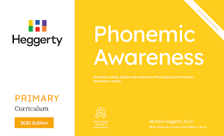
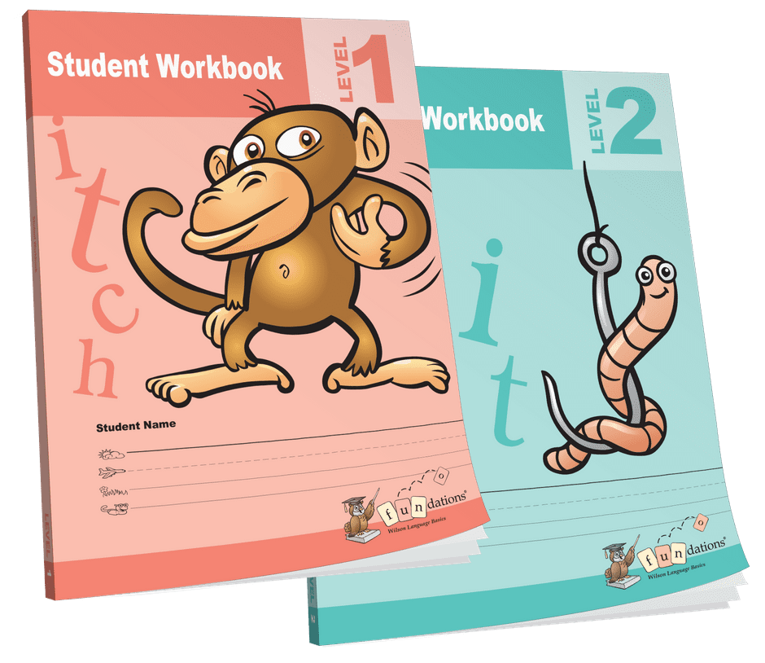
K-2 ELA Core Instruction
01
02
03
Phonological Awareness
Handwriting
Systematic & Explicit Phonics
04
05
06
Integrated Writing
Speaking & Listening Comprehension
Content-Rich, High Quality Read Alouds
Notes:
Teachers should choose the appropriate slide (K-2 or 3-5). For phonics, name Fundations.
SCRIPT:“Every student counts” We strive to know our students by name, strength and need. Our goal and expectation is literacy for all students and to develop strategic readers, effective writers, engaging speakers, and critical thinkers. We will accomplish this through high quality Tier I instruction aligned to the Science of Reading, as well as targeted, to support, to extend and intervene specific to each student’s needs. The ELA Office believes all children can learn to read skillfully, write expressively, and engage in higher-level discourse Elementary curriculum materials are aligned to the Science of Reading. All K-2 students will receive handwriting instruction (Handwriting Without Tears or Fundations), phonological awareness (Heggerty), phonics instruction (Fundations), speaking & listening comprehension, writing and reading comprehension using Core Knowledge Language Arts - CKLA.
**Before the start of each CKLA unit, we will send home a caregiver letter that will summarize what your child will be learning and sample questions you can use to dialogue with your child about their learning. At the end of the units, CKLA workbooks will be sent home.
With the introduction of a full suite of core curriculum (Tier I) aligned to the Science of Reading, guidance on Lexia usage has been updated. In the 23-24 school year, students will work in Lexia until they complete their grade level material and then discontinue its use at school. Lexia will continue to be used as an adaptive supplement for students remediating specific gaps in literacy skills.
Elementary ELA curricula and instructional practices are aligned to best practices in the Science of Reading. To learn more about APS’ approach to elementary literacy, please visit the APS English Language Arts website.

Slide 11
Mathematics
Supporting Your Child’s Learning in Kindergarten!
Our Kindergarten math curriculum is aligned with Virginia Standards of Learning (SOLs).
Students use a variety of hands-on materials and have a consumable workbook as an added learning support.
Notes:
Savvas/EnVision, Dreambox, and Reflex are high-quality resources used to support students’ learning and mastery of the Virginia Standards of Learning. In addition, these resources help support the personalized learning needs of students; from those requiring the firming up of prerequisite skills to those who require more depth, rigor, and/or practice. Students are able to access Savvas Realize/enVision materials digitally through Clever, have access to better supports at home, and have a consumable textbook to support math practice. Teachers will continue to use additional resources to ensure students are able to actively engage in all mathematics content as well as the math process goals. Last but not least, students will continue to have access to Dreambox to support personalized math strengthening and, when needed, Reflex Math to support math fact automaticity.

Slide 12
Science
All elementary schools have access to two digital resources (access through Clever)
Generation Genius for K-5 Science
Supplemental Resource
STEMscopes for K-5 Science
Primary Science Resource
Aligned with Virginia SOLs
Notes:
APS provides the elementary science program with two digital resources. Our K-5 primary resource is STEMscopes, which science content is aligned with the VA SOLs. In addition, all elementary schools have access to Generation Genius, which is a supplemental science resource that includes videos, interactives, and assessments. Both of these resources are integrated in the APS science curriculum and unit plans.

Slide 13
Social Studies K-3
Five Ponds Press
The DBQ Project
All students in grades K-3 have access to a digital textbook that is aligned with the Virginia Standards of Learning (access through Clever)
Supplemental resource available to all elementary schools that supports content standards and ELA writing standards.
Notes:
Teachers should choose the appropriate slide (K-3, Grade 4, Grade 5)
APS provides the K-3 social studies program with two resources. Our primary resource in grades K-3 is new this year. Students have access to Five Ponds Press digital textbooks. These textbooks are well aligned to the Virginia Standards of Learning. In addition, all elementary schools have access to The DBQ Project, which is a supplemental resource that asks students to explore sources and to develop arguments supported by evidence. Both of these resources are integrated in the APS social studies curriculum and unit plans.

Slide 14
Specials
Art
Music
Library
PE
MOSAIC/
Counseling
Notes:
Art, Music, Library: 1x/week
PE: 2x/week
MOSAIC: every other week, alternating with counseling lessons. MOSAIC follows Anti-Defamation League’s No Place for Hate program and anti-bias curriculum. It gives students time to learn about themselves and others, cultive a community that celebrates differences, understand bias and discrimination, and make a commitment to confront and challenge bias and bullying.

Slide 15
Standards-Based Grading & Reporting
2023-2024 Performance Levels
Meets Standard | The student shows full and consistent understanding of the standard independently.
Approaching Standard | The student shows partial and/or inconsistent understanding of the standard independently.
Developing Standard | The student shows initial understanding of the standard with support.
*Updated June 2023
Notes:
We will use Standards-Based Grading and Reporting to share with families your child’s learning journey of grade level learning standards through a Standards-Based Progress Report.
We will report progress to families 4 times per year (in grades 1-5) or 2 times per year in Kindergarten in Reading, Writing, Math, Science, Social Studies, Art, Music, PE and Social Emotional Learning.
We use 3 performance levels to communicate progress: Meets Standard, Approaching Standard, and Developing Standard. These performance levels were updated in June 2023. We also communicate progress to families throughout the year through parent -teacher conferences and student reflections.

Slide 16
English Learners Program
The English Learner (EL) team at Oakridge supports students from diverse cultural and linguistic backgrounds.
The EL team provides English Learners (ELs) and their classroom teachers with instruction, support, and resources.
During the language acquisition process, ELs are expected to meet and maintain the same high levels of academic achievement as their peers.

Slide 17
Special Education
APS provides a continuum of services for eligible students with disabilities, PreK through age 21, who are determined eligible to receive special education services.

Slide 18
Additional Support Staff
Occupational Therapist
Physical Therapist
School Psychologist
School Social Worker
Speech-Language Pathologists
Student Support Coordinator
APS also provides the following specialists, as needed: Vision, Hearing, Autism, Behavior, Audiology

Slide 19
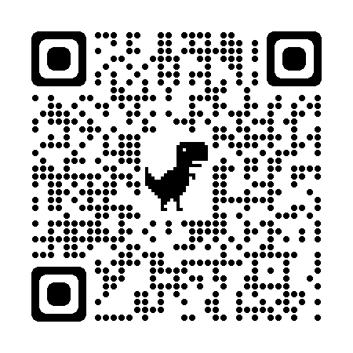
Gifted Services
The Advanced Academics Coach (AAC) works with teachers to provide access, affirmation, and advocacy for students.
The AAC’s primary role is to support teachers in meeting the daily differentiation needs of identified students.
The AAC provides gifted resources and critical & creative thinking strategies for ALL students through collaboration with teachers.
Students in 1st and 2nd grades take a Cognitive Abilities Test as a universal screening tool for gifted services.
Kirsten Spoto
kirsten.spoto@apsva.us
Frequently Asked Questions
Notes:
All students will be assessed in 1st and 2nd grade using a universal screener in November. Students in grades 3-5 new to APS without a universal screener score will also be assessed. Additionally, teachers, parents/guardians, or community members can refer students to gifted services and the student data will be reviewed as a team. Please view the FAQs and reach out to Kirsten Spoto if you have any questions.

Slide 20
Parent Website
For additional information about Kindergarten curriculum, please visit the APS Elementary Curriculum Website.
Information includes:
Year-At-A-Glance Grade Level Curriculum Calendars
Standards of Learning
Curriculum Framework
Websites for APS Content Offices
Notes:
*Teachers: Please insert your grade level as appropriate. Then remove highlight.
If you would like to learn more about our grade level curriculum and specific learning standards, please visit the APS Elementary Curriculum Website.

Slide 21
Extended Day Sign-Up
Official sign up dates will be posted on April 1st. Registration will start in May.
Please check the extended day webpage below.
https://www.apsva.us/extended-day/extended-day-program-information/

